Slide 1
Gyroscopic attitude control systems
Stepan Tkachev

Slide 2
Introduction
Attitude control systems
Passive
Active
Gyroscopic
Magnetic
Thrusters
Gravitational
Magnetic

Slide 3
Introduction
Attitude control systems
Need fields
Independent
Gyroscopic
Thrusters
Gravitational
Magnetic

Slide 4
Introduction
Attitude control systems
Need fields
Independent
Gyroscopic
Thrusters
Gravitational
Magnetic

Slide 5
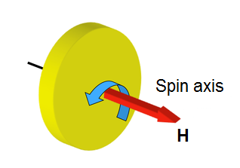
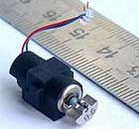
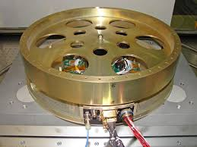
What are gyroscopic systems?
Cell phone vibration motor
Spacecraft reaction wheel

Slide 6
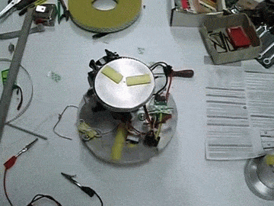
Principle of operation
Angular momentum conservation law
Control torque
You can create torque by
accelerating or decelerating
changing the angular momentum direction

Slide 7
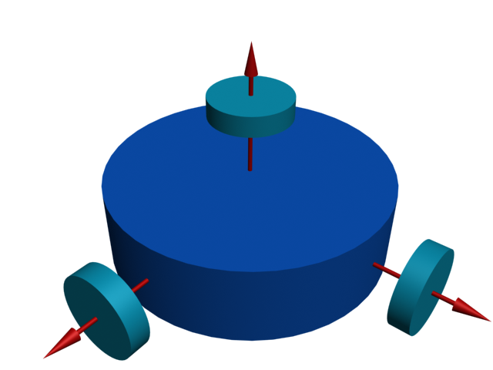
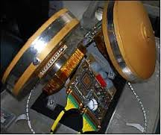
Reaction wheels
Axis of rotation is fixed
Main dynamical properties:
maximum torque
maximum angular momentum or spin rate

Slide 8
Saturation and desaturation
Control can be created only when angular rate is varied
You lost controllability when you can’t change the angular rate
Too small spin rate
Too high spin rate
Saturation
Magnetic control system
Need additional algorithms for desaturation
Thrusters

Slide 9
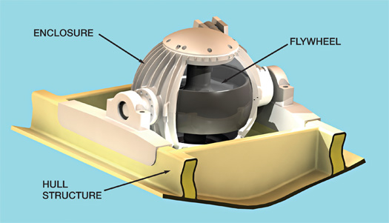
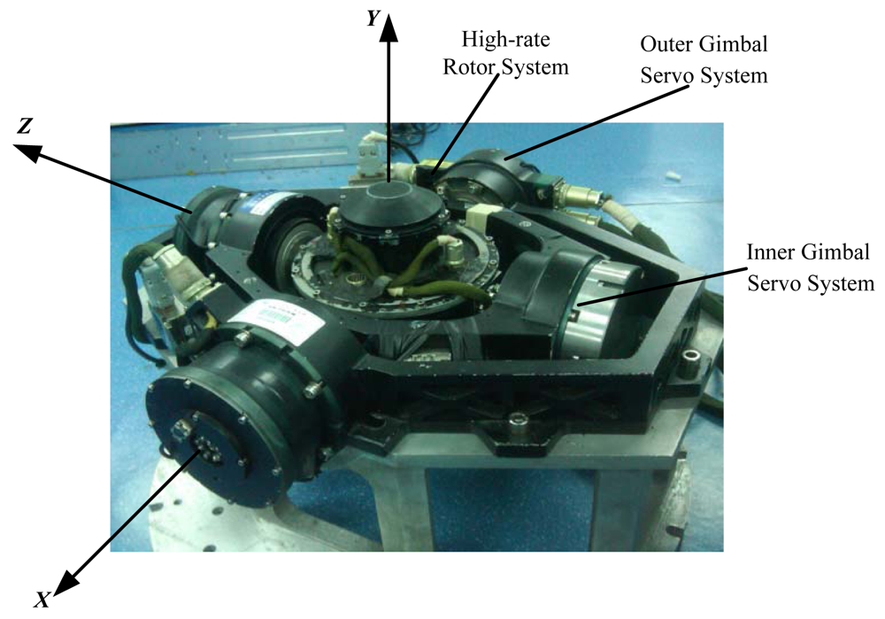
Gyroscopes
Axis of rotation can change its direction
Single gimbal control momentum gyro (SGCMG)
Main dynamical properties:
flywheel angular momentum
maximum gimbal spin rate
Dual gimbal control momentum gyro (DGCMG)

Slide 10
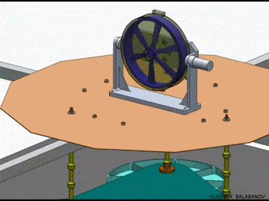
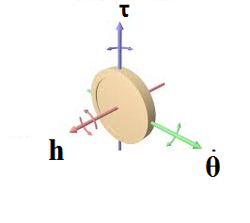
Single gimbal CMG

Slide 11
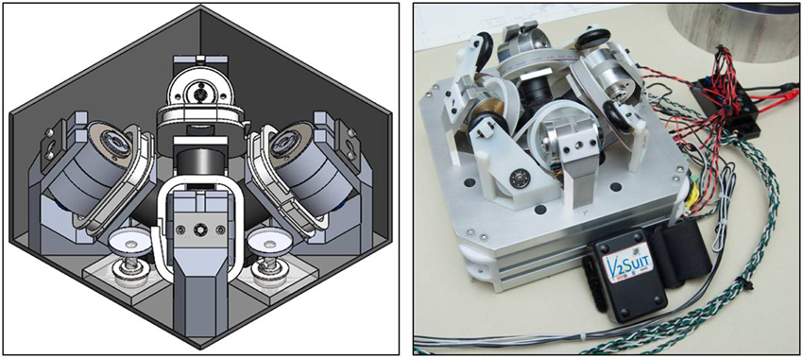
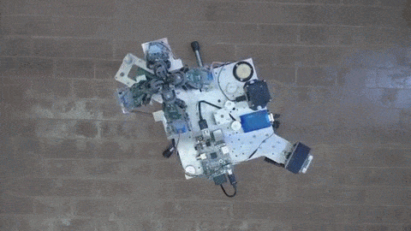
Single gimbal CMG
Pyramid type

Slide 12
Attitude control system operation
State identification
Control torque calculation
Angular momentum calculation
Gimbal angles calculation
Control application
Steering law

Slide 13
Steering law & singularities
Lost controllability
Singularity avoidance algorithm

Slide 14
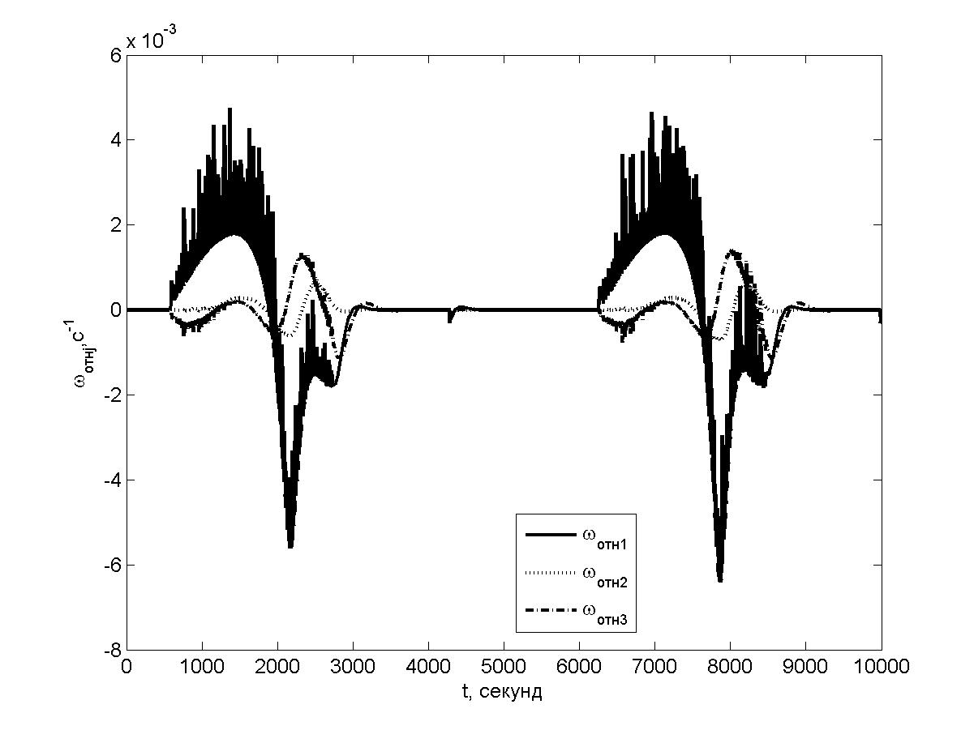
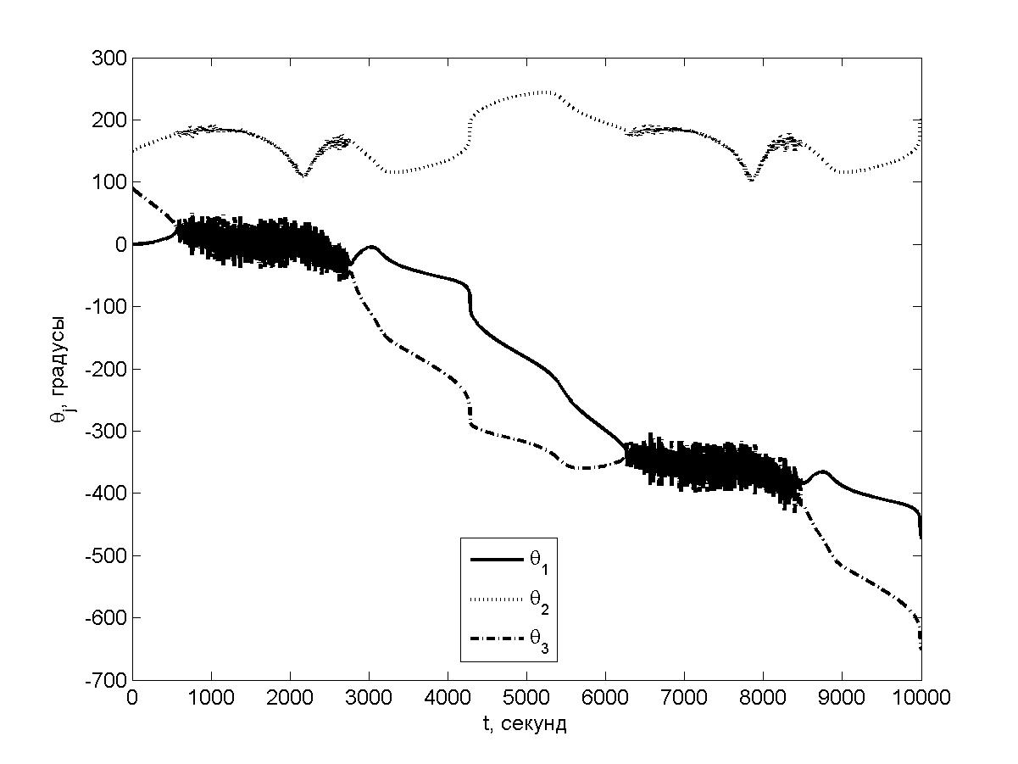
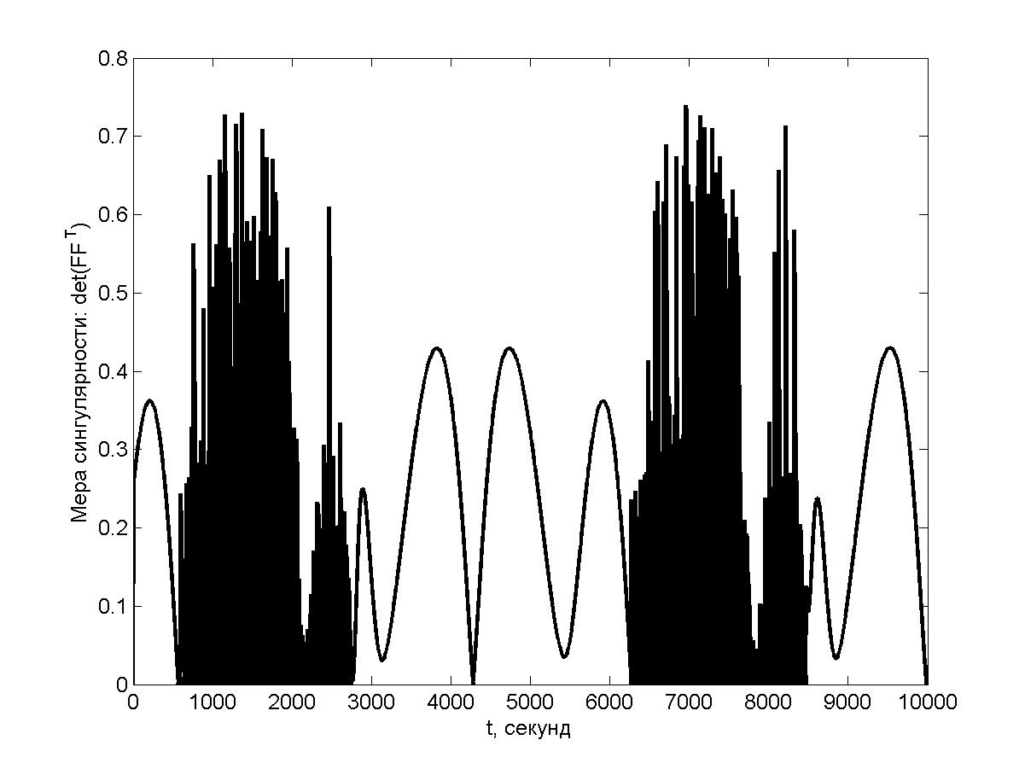
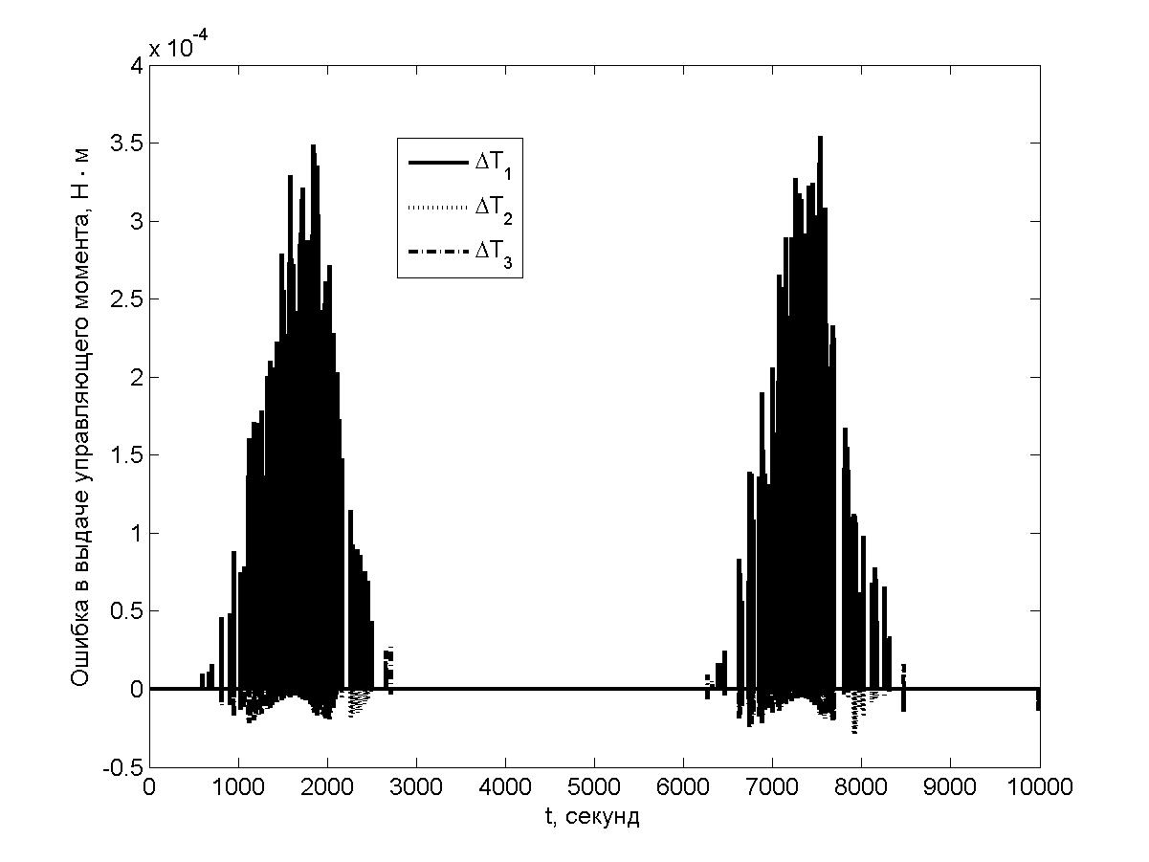
Illustrative example

Slide 15
RW vs. SGCMG vs. DGCMG
 | Reaction wheels | SGCMG | DGCMG
Hardware complexity | simple | complex | very complex
Algorithms | simple | very complex | complex
Output torque | small | big | big
Miniaturization | possible | possible | impossible

