Slide 1
Nanosatellites Triangle Formation Flying For Terrestrial Gamma-Ray Flashes and Transient Luminous Events Study
Yaroslav Mashtakov
Pavel Klimov, Anatoly Iyudin, Sergey Svertilov, Oleg Pansyrnyi, Igor Churilo, Mikhail Ovchinnikov, Danil Ivanov, Stepan Tkachev, Dmitry Roldugin, Sergey Shestakov

Slide 2
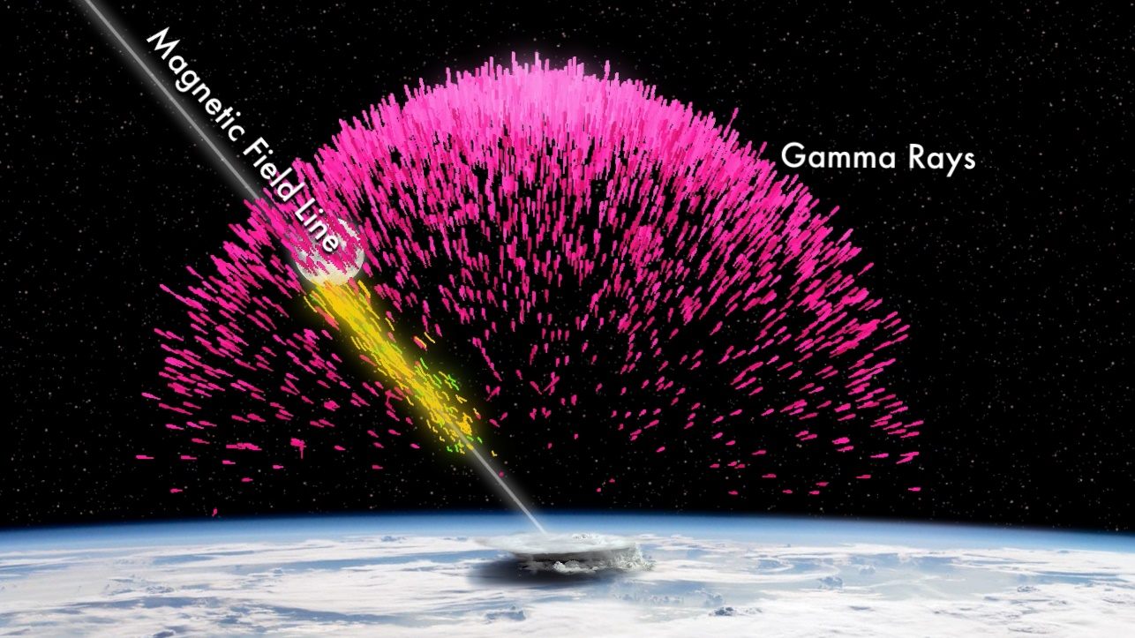
Introduction
Terrestrial Gamma-Ray Flashes are special events in the atmosphere
They are the burst of gamma rays produced in Earth's atmosphere
Such events were first discovered in 1994
We still don’t understand what creates them
Main theory – they are produced by lightning in the upper atmosphere

Slide 3
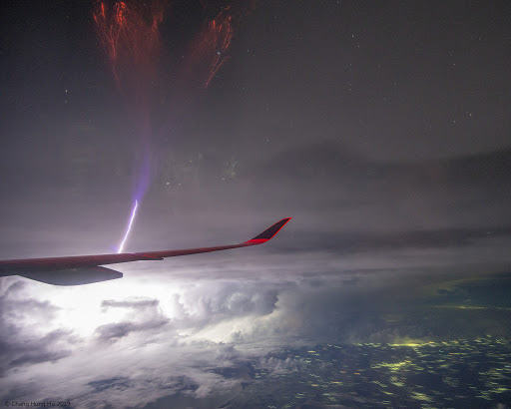
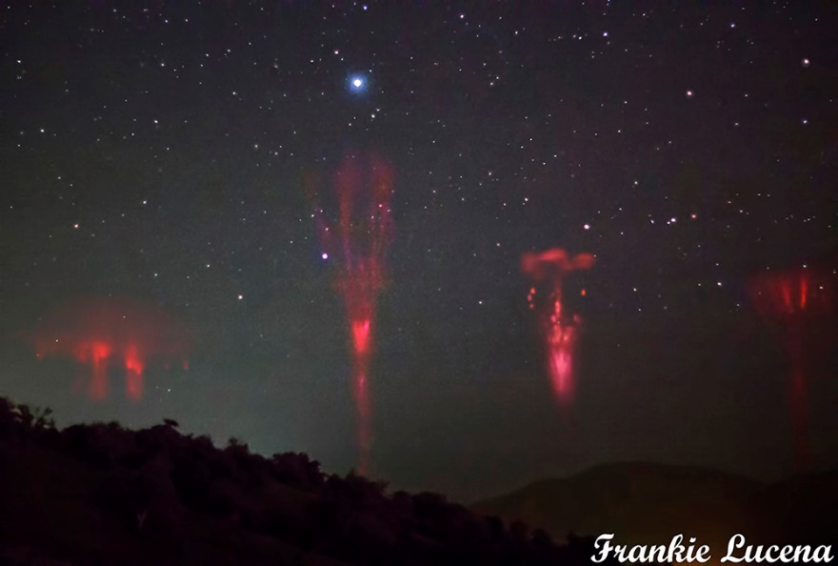
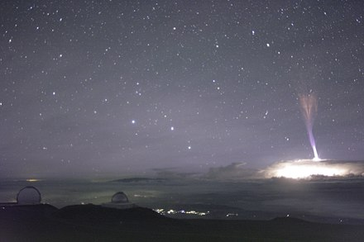
Introduction-2
We need to detect TGF and simultaneously detect any kind of lightning
It might provide useful information and allow us to develop theory that describes such events
Transient Luminous Effects

Slide 4
Problem statement
In order to determine TGF and lightning position we need at least three satellites with the necessary detectors
They must form equilateral triangle for better event triangulation
Region of interest is near-equatorial
We don’t know the necessary triangle side length, only estimation 100-1000 km

Slide 5
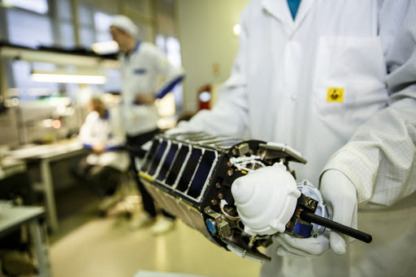
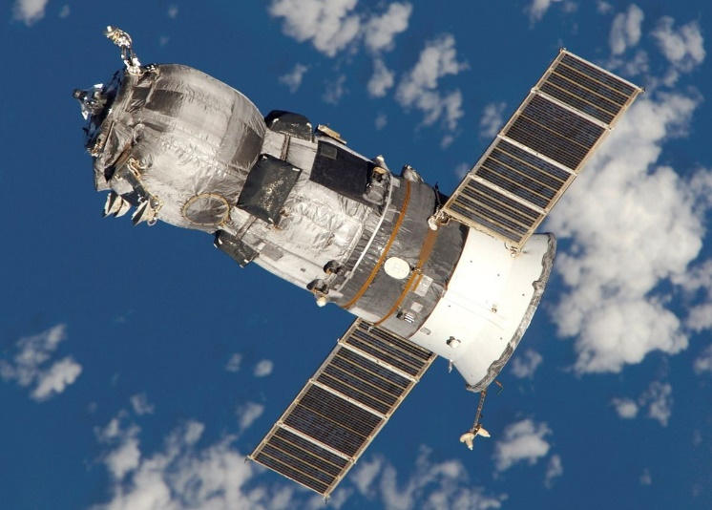
Problem statement-2
We use TNS-0 platform developed by Russian Space System Corporation
TNS nanosatellite platform has been successfully tested in two flights launched from ISS
Progress cargo ship is used to deliver satellites to the dedicated orbits from ISS

Slide 6
What are the orbits?
TNS is small satellite (close to 3U CubeSat)
We cannot use thrusters
We can utilize atmospheric drag (by changing satellite attitude)
J2 precession might help us
We use 2 satellites on the same orbit and 1 shifted by LAN

Slide 7
J2 precession
LAN precession is
Major semiaxes must be the same
We can slightly change inclination (around 0.2 deg), so triangle size changes from 1000 km to 100 km in around a year

Slide 8
Triangle side
To change triangle side we need to change difference between satellite’s arguments of latitude
We do it by drag utilization
Different cross-section of satellites – different accelerations
We can change it from 0.0275 m² to 0.05 m²
Cross-section of the first satellite is fixed to 0.038 m²
The others changed to either come up or come off the first satellite
Control law is similar to PD controller

Slide 9
Simulation
All satellites are affected by J2, central Newtonian Field and atmospheric drag
Atmospheric density includes information about solar activity, night/day time
Angular motion is not considered (it is modelled by different satellite cross-section area)
Satellite cross-sections are updated once in revolution

Slide 10
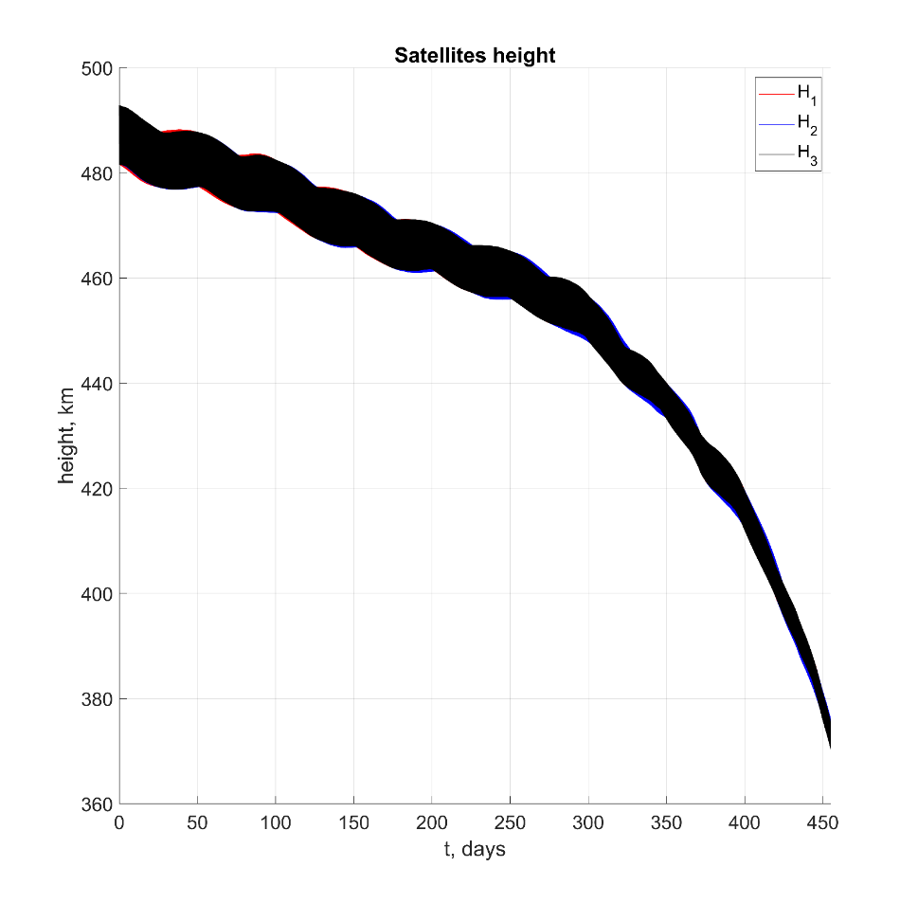
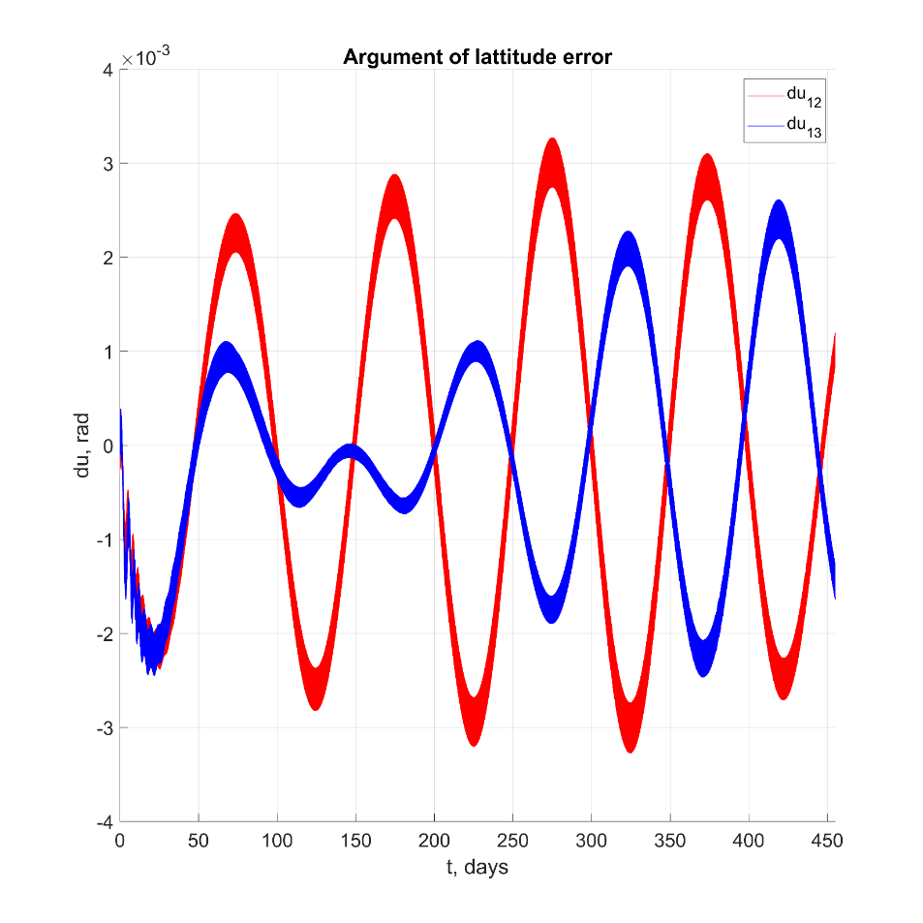
High solar activity (2013)

Slide 11
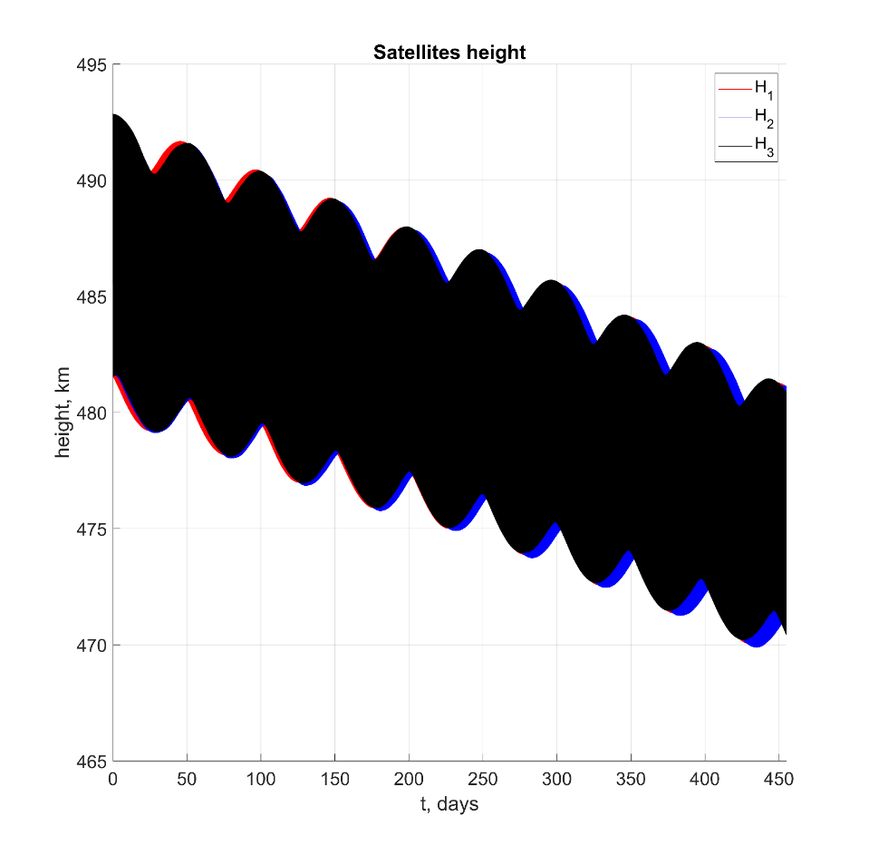
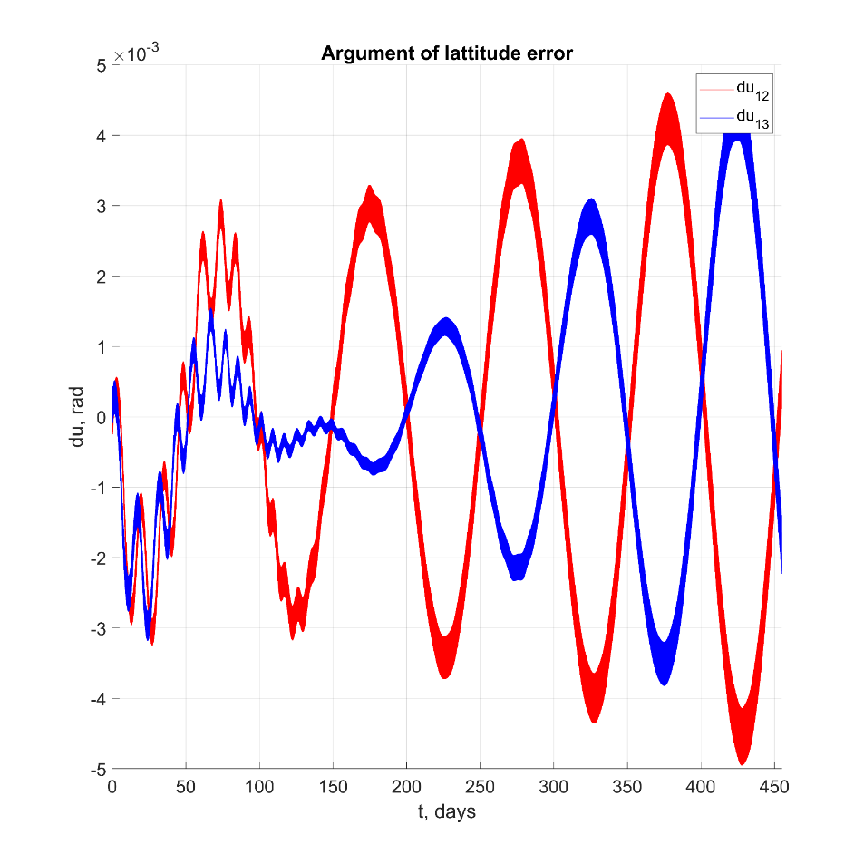
Low solar activity (2018)

Slide 12
Conclusion
We are able to construct triangle configuration in the near-equatorial region
We can change its size
However, we cannot prevent it from changing for this type of orbit
It is still a preliminary study – more precise model for gravity will be used
Angular motion was not considered – we are going to take a look at magnetic attitude control

Slide 13
Questions?
Contact information:
Yaroslav Mashtakov
Keldysh Institute of Applied Mathematics of RAS
YarMashtakov@gmail.com

